Slide 1
C++ Presentation
Pointer in C++
Constant
Amir Shrestha
BIT Sec”A”
Roll no. 6

Slide 2
What is a pointer?
Pointer / Pointers variables are :
variables that points to a specific address in the memory pointed by another variable.
variable that holds a memory address where a value lives.
Pointer is a programming language data type whose value refers directly to (or "points to") another value stored elsewhere in the computer memory using its address.

Slide 3
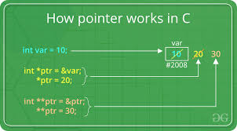
How to declare a pointer? int *ptr; OR int* ptr; The statement above defines a pointer variable ptr. It holds the memory address. Pointer variable ptr contains address of a variable var and the datatype of that variable var is int. and again pointer **ptr is a pointer variable that contains the addess of pointer ptr that contains the address variable var.here u can use *2ndptr instead of **ptr

Slide 4
Reference operator (&)
Dereference operator (*)
Reference operator (&) gives the address of a variable.
For example:
Likewise,to get the value stored in the memory address, we use the dereference operator (*).
If a number variable is stored in the memory address 0x123, and it contains a value 5.
The reference (&) operator gives the value 0x123, while the dereference (*) operator gives the value 5.

Slide 5
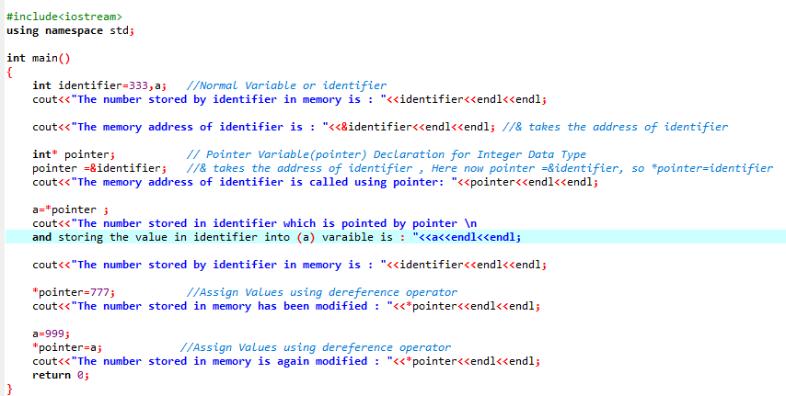
Example:

Slide 6
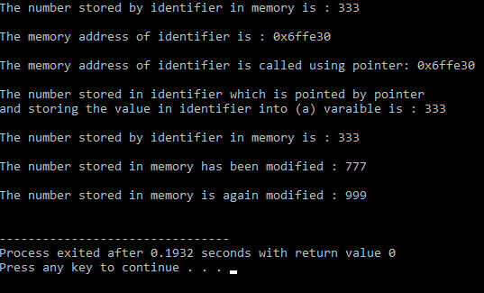
Output:

Slide 7
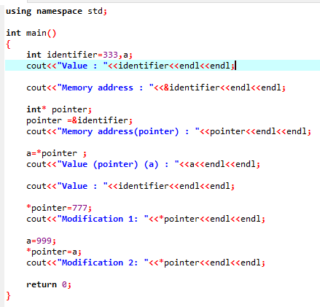
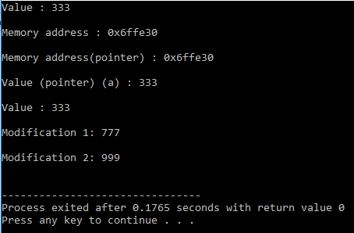
Simple form of example:

Slide 8
Constant
A constant is any expression that has a fixed value. Their value do not change during the execution of a program.
Constant can be divided into integer numbers , floating-point numbers , characters and strings.
Integer numbers
1889 , 709 , -275
whenever we are writing 1889 in our program we will be referring to the value 1889.
Floating point numbers
3.14159
6.02e23 here, the first number is PI, second one is the number of avogadro,

Slide 9
Characters and Strings
‘X’
“Hello World”
The first character is enclosed by single quote (‘) while the last strings is enclosed by double quote (“).
Escape Characters (Escape Sequence)
An escape sequence is a sequence of characters that does not represent itself ,but is translated into a sequence of characters that may be difficult or impossible to represent directly.

Slide 10
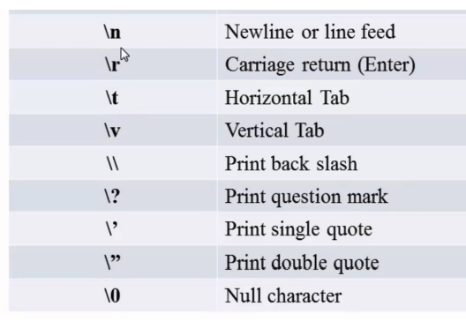
Here is the list of such escape codes:

Slide 11

Thank You

